Slide 1
ETNA TOWNSHIP Report
Introduction:
As Etna Township is a Rural Community, most residents will want to refrain from manufacturing major infrastructures and continue their current living circumstances with minor adjustments.
Presenters:
Khoa Ho
Keesha Joseph
Phuong Le
Hamdan Ashfaq

Slide 2
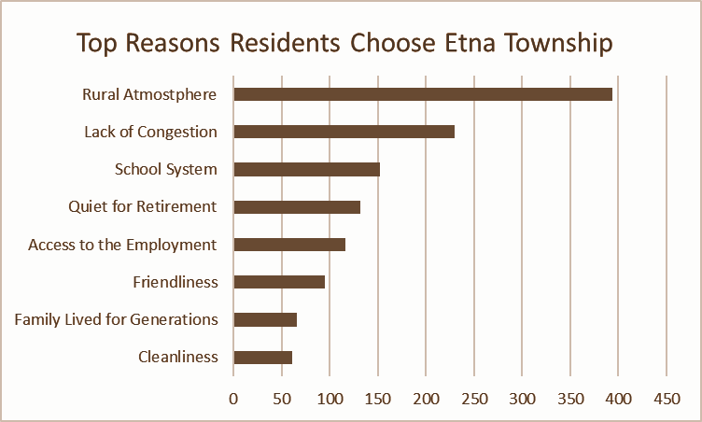
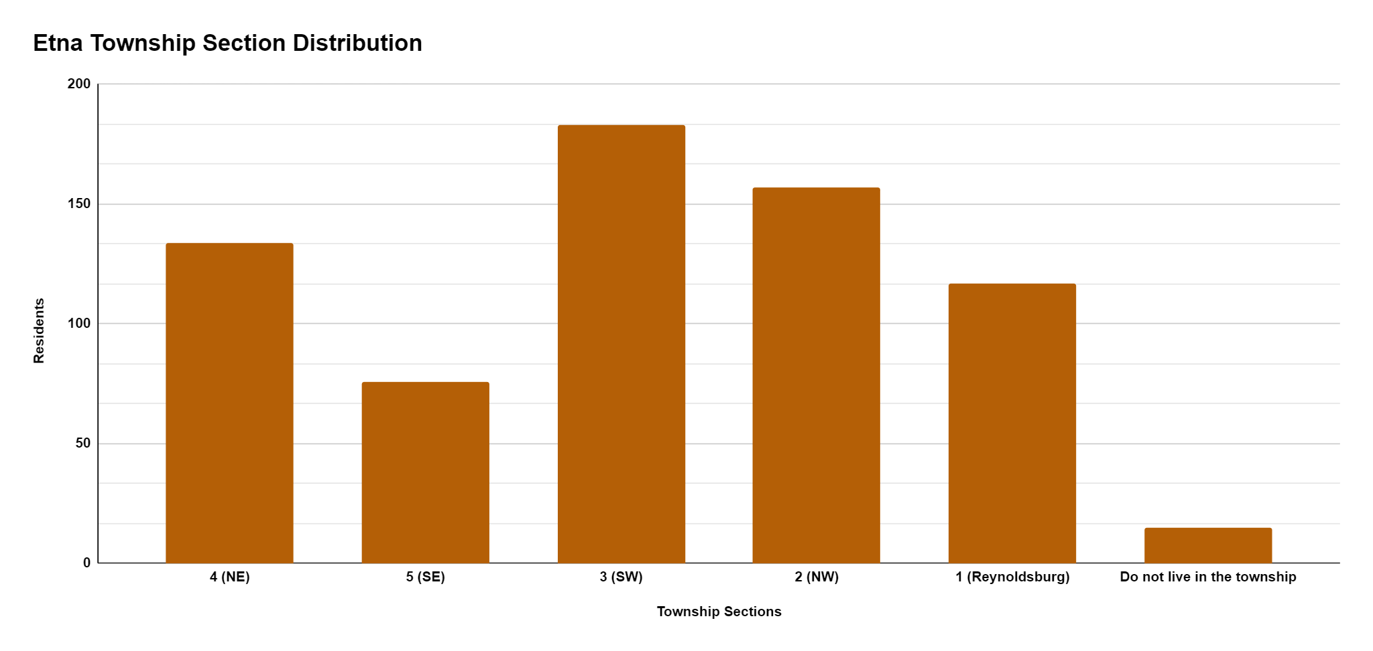
CONTENTS OF THIS TEMPLATE
The graph describes residents’ reasons for living in Etna Township.
Top 2 Reasons
Rural Atmosphere
Lack of Congestion: Traffic
Important because…
Helps assess where future opinions are originating from
Gives overview of public background
Establishes Township as attracting folks for Rural Residence.
The graph describes population distribution of Etna Township within the data.

Slide 3
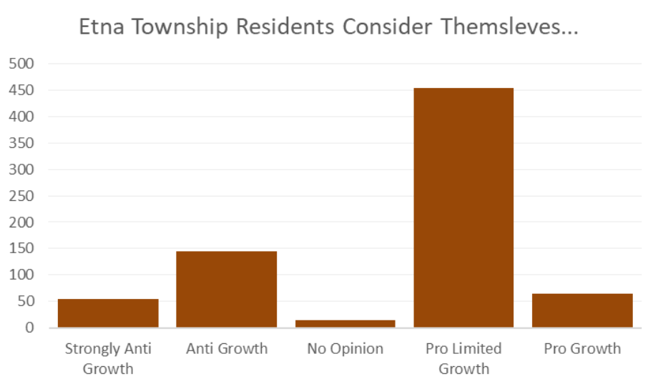
Pro Limited Growth has most votes
→ Residents are ready for changes to a certain extent
→ Mindset geared towards current preservation, not heavy industrialization
→ This prefaces attitudes residents have towards heavy manufacturing
The graph describes the level of Etna Township residents’ growth mindset.

Slide 4
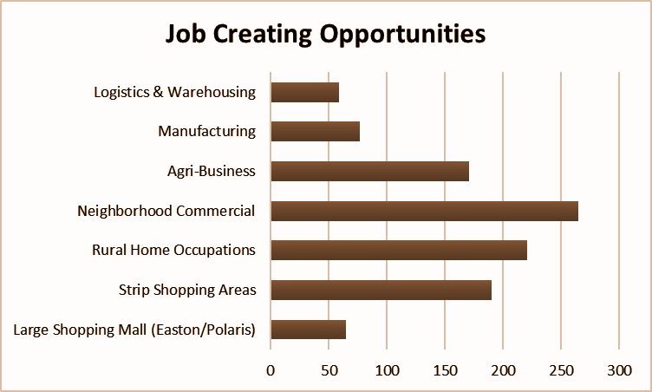
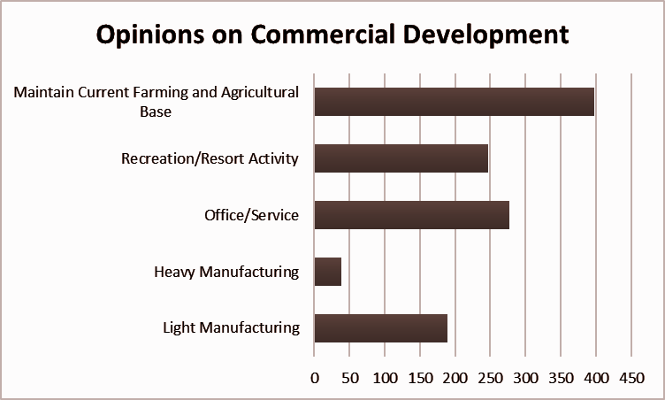
This graph describes the job opportunities Etna Township residents want to see more
Least supported:
Logistics & Warehouses
Most supported:
Neighborhood Commercial
This graph describes the commercial development that Etna Township residents want to see more
Least supported:
Heavy Manufacturing
Most supported:
Maintain Current Farming and Agricultural Base

Slide 5

Final observations
SUGGESTIONS
Temporarily stop building warehouses and focus on assessing community zoning needs:
Why ?
Residents are only ready for changes to a certain extent
There are demonstrated needs for other facilities
Warehouses increase traffic volume, changing landscape, and affecting the suburban atmosphere
How?
Invest in maintaining current farming and agricultural base instead
Develop neighborhood commercial job opportunities to replace employment warehouses
Take into account residents’ opinion more in the future: revision of the Board of Trustees
22% Trustee
26% other
12% traffic
28% warehouse
12% tax
This is a pie chart of the most mentioned key words found in the free-response section at the end of the survey.
Notes:
Other facilities, such as…
Commercial Jobs

Slide 6
Fin.
Thank you!
Credit: Slidesgo

